Slide 1
Pursuing his glory & our excellence
THE ADDITION OF ENDURANCE
2 Peter 1:5
Part 5

Slide 2
2 Peter 1:3-9
³ According as his divine power hath given unto us all things that pertain unto life and godliness, through the knowledge of him that hath called us to glory and virtue: ⁴ Whereby are given unto us exceeding great and precious promises: that by these ye might be partakers of the divine nature, having escaped the corruption that is in the world through lust.

Slide 3
⁵ And beside this, giving all diligence, add to your faith virtue; and to virtue knowledge;
⁶ And to knowledge temperance; and to temperance patience; and to patience godliness; ⁷ And to godliness brotherly kindness; and to brotherly kindness charity.

Slide 4
⁸ For if these things be in you, and abound, they make you that ye shall neither be barren nor unfruitful in the knowledge of our Lord Jesus Christ. ⁹ But he that lacketh these things is blind, and cannot see afar off, and hath forgotten that he was purged from his old sins.

Slide 5
The Call of God for us
To live a life that brings Glory to Christ.
To live a life of Moral Excellence.

Slide 6
What Have we learned:
God has provided all we need to live for Him.
God has provided a spiritual process for us, whereby we can give Him glory and develop moral excellence in our lives.
God has enter into a divine partnership with us to accomplish His will in our lives.

Slide 7
God has Provided Power of His Spiritual Addition for us:
Our Faith!
Add to Our Faith Virtue – Moral Excellence
Add to Our Moral Excellence – Practical Knowledge of Christ.
Add to Our Practical Knowledge of Christ – Self-Control.

Slide 8
Add to Self-Control Endurance
The Greek word for “Patient” means Endurance and is used 32 times in the New Testament. 1 time it is in translated patient enduring, 21 times perseverance and 3 times steadfastness.
It means to abide under, the discipline to remain under pressure.

Slide 9
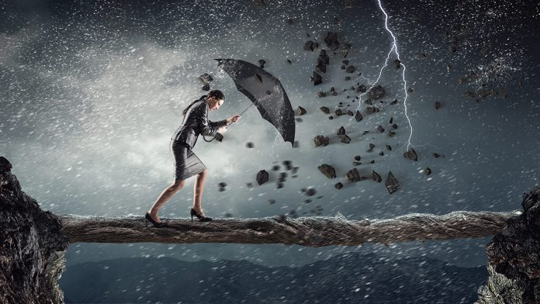
It is the picture of steadfastly and unflinchingly bearing up under heavy pressure.
It is the quality not to allow circumstances and trials
to cause you to give in, give up or simply quit.

Slide 10
James 1:2-4 – My brethren, count it all joy when ye fall into divers temptations; ³ Knowing this, that the trying of your faith worketh patience. ⁴ But let patience have her perfect work, that ye may be perfect and entire, wanting nothing.

Slide 11
Romans 12:12 – Rejoicing in hope; patient in tribulation; continuing instant in prayer;

Slide 12
Endurance is that quality of inner strength for the Believer.
Where does this strength come from?
How do I apply it to my life?
How does it work? from?

Slide 13
Where does this strength comes from? God!
Galatians 5:22-23 – But the fruit of the Spirit is love, joy, peace, longsuffering, kindness, goodness, faithfulness, ²³ gentleness, self-control. Against such there is no law.

Slide 14
How do I apply this Endurance to my life and How does it Work?
Look to Jesus and realize He is the WHY!
Embrace Jesus and your purpose!
Jesus plus your Divine Purpose Equal Joy!

Slide 15
Hebrews 12:1-3 – Wherefore seeing we also are compassed about with so great a cloud of witnesses, let us lay aside every weight, and the sin which doth so easily beset us, and let us run with patience the race that is set before us,

Slide 16
² Looking unto Jesus the author and finisher of our faith; who for the joy that was set before him endured the cross, despising the shame, and is set down at the right hand of the throne of God.

Slide 17
³ For consider him that endured such contradiction of sinners against himself, lest ye be wearied and faint in your minds.

Slide 18
How do I apply this Endurance to my life and How does it Work?
Look to Jesus and realize He is the WHY!
Embrace Jesus and your purpose!
Jesus plus your Divine Purpose Equal Joy!

Slide 19
Philippians 3:10-14
¹⁰ That I may know him, and the power of his resurrection, and the fellowship of his sufferings, being made conformable unto his death; ¹¹ If by any means I might attain unto the resurrection of the dead.

Slide 20
¹² Not as though I had already attained, either were already perfect: but I follow after, if that I may apprehend that for which also I am apprehended of Christ Jesus.

Slide 21
¹³ Brethren, I count not myself to have apprehended: but this one thing I do, forgetting those things which are behind, and reaching forth unto those things which are before, ¹⁴ I press toward the mark for the prize of the high calling of God in Christ Jesus.

