Slide 1
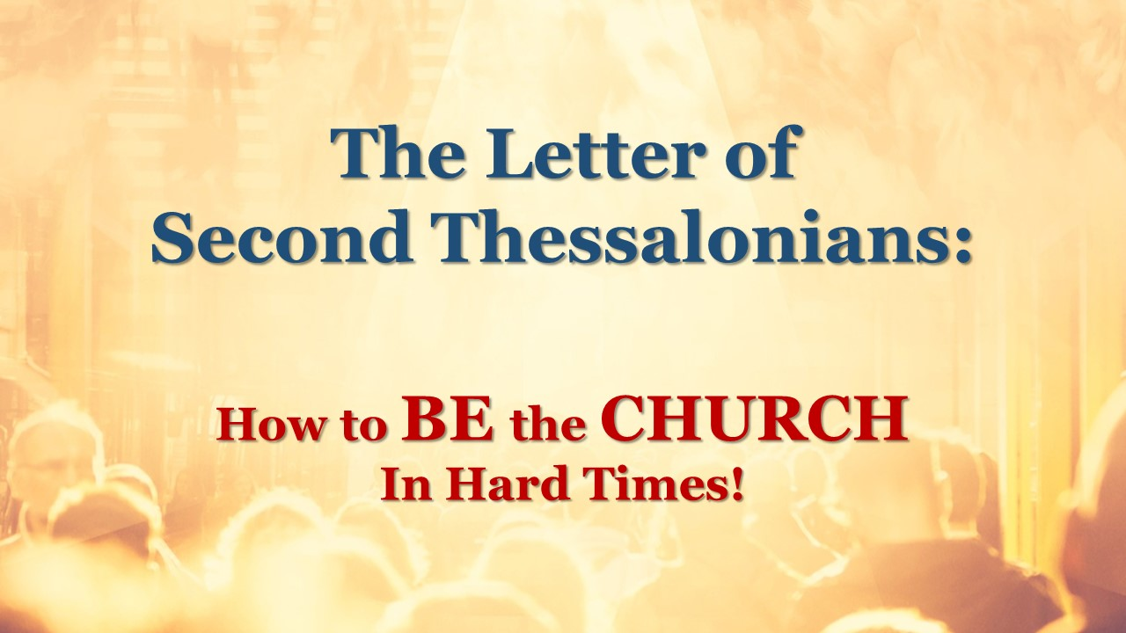
Notes:
Paul wrote both letters to Thessalonian Christians from Corinth. A City that he spent some 18 months in. He wrote the First Letter in his first few months there after receiving Timothy great report about them.
A few months after the first letter he wrote the second letter to them. We do not know what prompted him writing the Second Letter. This powerful and rich letter brought the church great instruction and encouragement.
He offered them spiritual encouragement for the hardship they were facing.
2) He address the confusion that still existence about the Second Coming of Christ.
He address the conduct of Christians that had become idle just sitting around
waiting for the return of Christ rather than serving.
The First Chapter deals subject of having spiritual perseverance in face of hardships.
In the Second Chapter Paul straightens out the beliefs about the Second Coming.
Third Chapter, he rebuke those who had become spiritually lazy.

Slide 2
AUTHENTIC PRAYER
Praying for God’s Priorities
Part II!

Slide 3
2 Thessalonians 1:11-12 – Wherefore also we pray always for you, that our God would count you worthy of this calling, and fulfil all the good pleasure of his goodness, and the work of faith with power:
¹² That the name of our Lord Jesus Christ may be glorified in you, and ye in him, according to the grace of our God and the Lord Jesus Christ.

Slide 4
Authentic Praying is act of coming in line with God, our Heavenly Father and His will for our lives. It is not a practice whereby we ask God to line up behind our desires and pursues. We line up behind Him!

Slide 5
What We Should Pray For:
That Christians Would Live Worthy of Their Calling.
2 Thessalonians 1:11 – Wherefore also we pray always for you, that our God would count you worthy of this calling, and fulfil all the good pleasure of his goodness, and the work of faith with power:
Notes:
That Christians would be worthy of God’s call on their lives.
“That our God would count you worthy” that you would live and behave in accordance of who you are. Who you are entitled to be.
You were called to be sons and daughters of God.
Romans 8:29-30 – For whom he did foreknow, he also did predestinate to be conformed to the image of his Son, that he might be the firstborn among many brethren.
³⁰ Moreover whom he did predestinate, them he also called: and whom he called, them he also justified: and whom he justified, them he also glorified.
Romans 11:29 – For the gifts and calling of God are without repentance.
We are to be what we have been called to be – Sons and Daughters of God.
Note: Positionally we are the Children of God – what Paul is praying for is that we would Practice who we are.

Slide 6
Living Worthy of the Call of God Involves:
A life filled with Spiritual Growth – Faith, Hope and Love.
A life that Identifies with Christ practice.
A life of Spiritual Endurance.

Slide 7
What We Should Pray For:
That Christians Would Fulfill God’s Good Pleasure in their lives.
2 Thessalonians 1:11 – Wherefore also we pray always for you, that our God would count you worthy of this calling, and fulfil all the good pleasure of his goodness, and the work of faith with power:
Notes:
The word “Fulfill” means to satisfied God’s desires for them in their lives. To experience all the goodness and benefits that God has for them. Not to miss any of God riches in their lives.
2) “Good Pleasures” – God desires, His Kindness, His favor, His riches for lives.
3) Paul prays that the Christians would fulfill receive all God has intended for Him – they would experience the blessings of God.
Psalm 21:2-3 – Thou hast given him his heart's desire, and hast not withholden the request of his lips. Selah.
³ For thou preventest (meet) him with the blessings of goodness: thou settest a crown of pure gold on his head.
Psalm 37:4 – Delight thyself also in the LORD; and he shall give thee the desires of thine heart.

Slide 8
Psalm 138:1 - The LORD will perfect that which concerneth me: thy mercy, O LORD, endureth for ever: forsake not the works of thine own hands.
Psalm 145:16 – Thou openest thine hand, and satisfiest the desire of every living thing.

Slide 9
What We Should Pray For:
That Christians Would Demonstrate Faith and Power in their lives.
2 Thessalonians 1:11 – Wherefore also we pray always for you, that our God would count you worthy of this calling, and fulfil all the good pleasure of his goodness, and the work of faith with power:
Notes:
He praying that the Christian’s Faith in Christ would be dynamic and alive that the results would be Spiritual Power.
2) Work – means deed and actions – behavior.
3) Faith – assurance and confidence.
4) Power – miraculous ability and strength
Note: True Authentic always has work and power involved – No faith, no work, no fruit and no miraculous power.
James 2:17-18 – Even so faith, if it hath not works, is dead, being alone.
¹⁸ Yea, a man may say, Thou hast faith, and I have works: shew me thy faith without thy works, and I will shew thee my faith by my works.
He is praying that the Christian would live a life filled with the demonstration of Faith in God that produces a powerful response from God.

Slide 10
Ephesians 2:10 – For we are his workmanship, created in Christ Jesus unto good works, which God hath before ordained that we should walk in them.
Notes:
Ephesians 3:14-17 – For this cause I bow my knees unto the Father of our Lord Jesus Christ,
¹⁵ Of whom the whole family in heaven and earth is named,
¹⁶ That he would grant you, according to the riches of his glory, to be strengthened with might by his Spirit in the inner man;
¹⁷ That Christ may dwell in your hearts by faith; that ye, being rooted and grounded in love,

Slide 11
What Should Be Prayed For:
That Christians Would Glorify Christ in our lives.
2 Thessalonians 1:12 – That the name of our Lord Jesus Christ may be glorified in you, and ye in him, according to the grace of our God and the Lord Jesus Christ.
Notes:
He praying that the Christian’s Faith in Christ would be dynamic and alive that the results would be Spiritual Power.
2) Work – means deed and actions – behavior.
3) Faith – assurance and confidence.
4) Power – miraculous ability and strength
James 2:17-18 – Even so faith, if it hath not works, is dead, being alone.
¹⁸ Yea, a man may say, Thou hast faith, and I have works: shew me thy faith without thy works, and I will shew thee my faith by my works.
He is praying that the Christian would live a life filled with the demonstration of Faith in God that produces a powerful response from God.

Slide 12
John 17:20-23 – Neither pray I for these alone, but for them also which shall believe on me through their word;
²¹ That they all may be one; as thou, Father, art in me, and I in thee, that they also may be one in us: that the world may believe that thou hast sent me.
²² And the glory which thou gavest me I have given them; that they may be one, even as we are one:

Slide 13
²³ I in them, and thou in me, that they may be made perfect in one; and that the world may know that thou hast sent me, and hast loved them, as thou hast loved me.

Slide 14
What We Should Pray for:
That we would live worthy of our calling.
That we would experience God’s good pleasure.
That we would demonstrate faith and power.
That we would glorify the name of Jesus Christ, Our Lord.

