Slide 1
Notes:
Paul wrote both letters to Thessalonian Christians from Corinth. A City that he spent some 18 months in. He wrote the First Letter in his first few months there after receiving Timothy great report about them.
A few months after the first letter he wrote the second letter to them. We do not know what prompted him writing the Second Letter. This powerful and rich letter brought the church great instruction and encouragement.
He offered them spiritual encouragement for the hardship they were facing.
2) He address the confusion that still existence about the Second Coming of Christ.
He address the conduct of Christians that had become idle just sitting around
waiting for the return of Christ rather than serving.
The First Chapter deals subject of having spiritual perseverance in face of hardships.
In the Second Chapter Paul straightens out the beliefs about the Second Coming.
Third Chapter, he rebuke those who had become spiritually lazy.

Slide 2
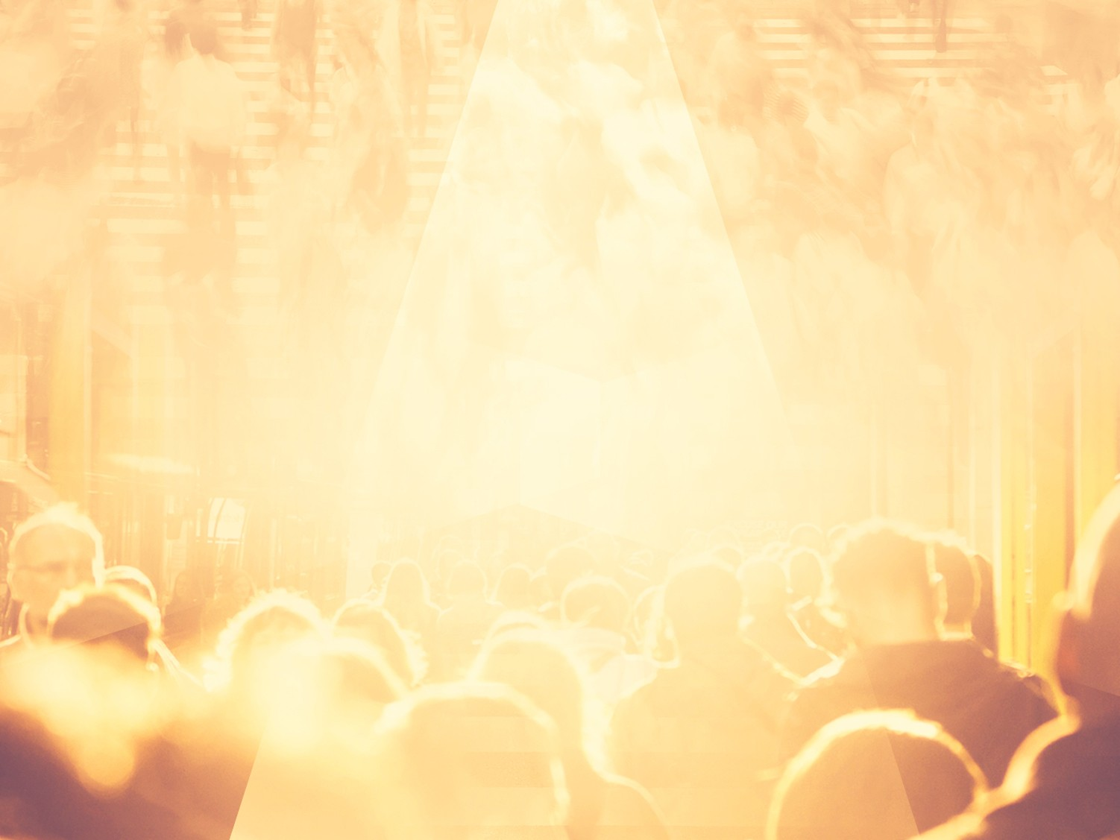
MARKS OF
A GREAT CHURCH!

Slide 3
How does the Bible measure the greatest of a church?
By its size – No!
By its programs & activities – No!
By its property and buildings – No!
By its great music and musicians – No!

Slide 4
By its wealth and resources – No!
By its Pastor and Staff – No!
By its theology and orthodoxy – No!
Notes:
Paul opens up this powerful letter by bragging on how proud he was of them. He numerate in the first five verses marks that make for a great church that would please God.

Slide 5
2 Thessalonians 1:1-5
¹ Paul, Silvanus, and Timothy, To the church of the Thessalonians in God our Father and the Lord Jesus Christ: ² Grace to you and peace from God our Father and the Lord Jesus Christ.

Slide 6
³ We are bound to thank God always for you, brethren, as it is fitting, because your faith grows exceedingly, and the love of every one of you all abounds toward each other, ⁴ so that we ourselves boast of you among the churches of God for your patience and faith in all your persecutions and tribulations that you endure, ⁵ which is manifest evidence of the righteous judgment of God, that you may be counted worthy of the kingdom of God, for which you also suffer;

Slide 7
The Mark of An Authentic Salvation: They were Real.
2 Thessalonians 1:1-2 – Paul, Silvanus, and Timothy, To the church of the Thessalonians in God our Father and the Lord Jesus Christ: ² Grace to you and peace from God our Father and the Lord Jesus Christ.
Notes:
Paul addresses them not as a group or a club – but a God called out assembly from the world that was IN God In Christ spirit with Holy Spirit.
An authentic church is an assembly of saved people who have a relationship with
God through the redemptive work of Jesus Christ.
Note: the only way you can ever be apart of the church is have a real relationship with Jesus – the church is made up of saved people.
An authentic Church is an assemble of Saved people that honor Jesus Christ through
Identification – He is the only source of our Salvation. “In Christ”
Worship, He is the object of all true worship.
Edification, He is the subject of all teaching and preaching.
Witnessing, He is vocal point of all proclamation.
Ministry, He is motive for all acts of Christian love.

Slide 8
2) The Mark of An Active Faith They were Believing.
2 Thessalonians 1:3 – We are bound to thank God always for you, brethren, as it is fitting, because your faith grows exceedingly, and the love of every one of you all abounds toward each other,
Notes:
Paul declares to this church that they had deserved the right for Paul to brag on their faith and to thank God for it – because it was growing and increasing.
Remember it is faith that pleases God – not all the other stuff.
Hebrews 11:6 – But without faith it is impossible to please Him, for he who comes to God must believe that He is, and that He is a rewarder of those who diligently seek Him.
1 Thessalonians 1:3 – remembering without ceasing your work of faith, labor of love, and patience of hope in our Lord Jesus Christ in the sight of our God and Father,
1 Thessalonians 3:10 – night and day praying exceedingly that we may see your face and perfect what is lacking in your faith?
Note: In light of the persecution they were still trusting God.
Note: Trials and test reveal if our faith is real or not.

Slide 9
3) The Mark of An Abounding Love – They Were Loving.
2 Thessalonians 1:3 – We are bound to thank God always for you, brethren, as it is fitting, because your faith grows exceedingly, and the love of every one of you all abounds toward each other,
Notes:
They had the mark of Agape Love in their assembly – they had acts of God’s love.
1 Thessalonians 1:3 – remembering without ceasing your work of faith, labor of love, and patience of hope in our Lord Jesus Christ in the sight of our God and Father,
They work at loving one another.
1 Thessalonians 3:12 – And may the Lord make you increase and abound in love to one another and to all, just as we do to you,
Note: The Mark of a Great Church is it is a loving church.

Slide 10
John 13:34-35 – A new commandment I give unto you, That ye love one another; as I have loved you, that ye also love one another. ³⁵ By this shall all men know that ye are my disciples, if ye have love one to another.

Slide 11
4) The Mark of Endurance – They Refused to Quit.
2 Thessalonians 1:4 – so that we ourselves boast of you among the churches of God for your patience and faith in all your persecutions and tribulations that you endure,
Notes:
The “Patience” means to be steadfast and to endure to persevere. The ability to stand firm in the midst of hard times.
Persecutions and tribulations – means all types of trouble and trials against one’s self and faith.
Endure – to bear up, to forbear, to suffer but stand.
1 Thessalonians 1:3 ³ Remembering without ceasing your work of faith, and labour of love, and patience of hope in our Lord Jesus Christ, in the sight of God and our Father;
2 Thessalonians 3:3-5 ³ But the Lord is faithful, who shall stablish you, and keep you from evil. ⁴ And we have confidence in the Lord touching you, that ye both do and will do the things which we command you. ⁵ And the Lord direct your hearts into the love of God, and into the patient waiting for Christ.

Slide 12
10,000 Churches a Year Close in America.
A Lifeway survey found, that over
500 pastors a month leave the ministry.

Slide 13
Results of their Endurance:
It was a testimony to their authentic faith in Christ.
It was evidence of their devotion to the cause of Christ.
It was proof that there is a coming day of Judgment.

Slide 14
5) The Mark of An Attitude for the Eternal – They Lived for Eternity.
2 Thessalonians 1:5 – which is manifest evidence of the righteous judgment of God, that you may be counted worthy of the kingdom of God, for which you also suffer;
Notes:
This church possessed a Heavenly Perspective – an attitude for the Eternal.
They viewed their lives, the ministry, their sufferings and hardship in light of Eternity.
Matthew 6:33 – But seek ye first the kingdom of God, and his righteousness; and all these things shall be added unto you.
Note: They understood truths about God –
God sits on a throne and rules the universe
They belong to God – He is their Father, Jesus is their Savior and Holy Spirit is Power.
One Day God will execute righteous judgment upon this earth.
Because of What Christ had done for them giving them their heavenly perspective, a growing faith, an abounding love, producing in them an endurance in their life and faith – Paul said, it was your may be counted worthy of the Kingdom of God.
It does not mean to make worthy but they are declared worthy, counted worthy.

Slide 15
John 15:20-21 – Remember the word that I said unto you, The servant is not greater than his lord. If they have persecuted me, they will also persecute you; if they have kept my saying, they will keep yours also. ²¹ But all these things will they do unto you for my name's sake, because they know not him that sent me.

Slide 16
2 Timothy 3:12 – Yea, and all that will live godly in Christ Jesus shall suffer persecution.
2 Corinthians 4:11 – For we which live are alway delivered unto death for Jesus' sake, that the life also of Jesus might be made manifest in our mortal flesh.

Slide 17
Marks of a Great Church
An Authentic Salvation – They were Real!
An Active Faith – They were Believing!
An Abounding Love – They were Loving!
An Abiding Endurance – They Refused to Quit
An Attitude for the Eternal – They lived for the Eternity.

