Slide 1
Notes:
Paul wrote both letters to Thessalonian Christians from Corinth. A City that he spent some 18 months in. He wrote the First Letter in his first few months there after receiving Timothy great report about them.
A few months after the first letter he wrote the second letter to them. We do not know what prompted him writing the Second Letter. This powerful and rich letter brought the church great instruction and encouragement.
He offered them spiritual encouragement for the hardship they were facing.
2) He address the confusion that still existence about the Second Coming of Christ.
He address the conduct of Christians that had become idle just sitting around
waiting for the return of Christ rather than serving.
The First Chapter deals subject of having spiritual perseverance in face of hardships.
In the Second Chapter Paul straightens out the beliefs about the Second Coming.
Third Chapter, he rebuke those who had become spiritually lazy.

Slide 2
2 Thessalonians 1:4-6 – So that we ourselves glory in you in the churches of God for your patience and faith in all your persecutions and tribulations that ye endure: ⁵ Which is a manifest token of the righteous judgment of God, that ye may be counted worthy of the kingdom of God, for which ye also suffer: ⁶ Seeing it is a righteous thing with God to recompense tribulation to them that trouble you;

Slide 3
⁷ And to you who are troubled rest with us, when the Lord Jesus shall be revealed from heaven with his mighty angels, ⁸ In flaming fire taking vengeance on them that know not God, and that obey not the gospel of our Lord Jesus Christ:

Slide 4
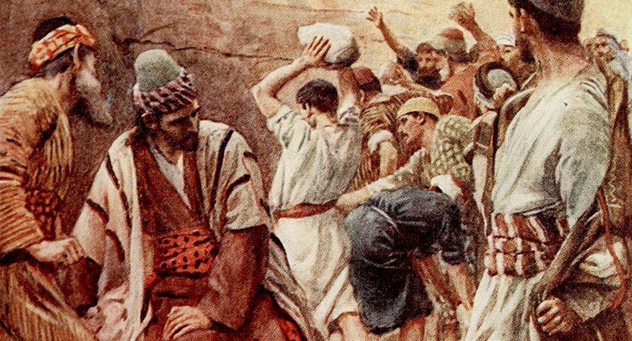
The church of Thessalonica was being severely persecuted.

Slide 5
Acts 17:5-8 – But the Jews which believed not, moved with envy, took unto them certain lewd fellows of the baser sort, and gathered a company, and set all the city on an uproar, and assaulted the house of Jason, and sought to bring them out to the people. ⁶ And when they found them not, they drew Jason and certain brethren unto the rulers of the city, crying, These that have turned the world upside down are come hither also;

Slide 6
⁷ Whom Jason hath received: and these all do contrary to the decrees of Caesar, saying that there is another king, one Jesus. ⁸ And they troubled the people and the rulers of the city, when they heard these things.

Slide 7
Acts 17:13 – But when the Jews of Thessalonica had knowledge that the word of God was preached of Paul at Berea, they came thither also, and stirred up the people.
1 Thessalonians 1:6 – And ye became followers of us, and of the Lord, having received the word in much affliction, with joy of the Holy Ghost:

Slide 8
1) Retribution and Revenge Belongs to God.
2 Thessalonians 1:6-7 – Seeing it is a righteous thing with God to recompense tribulation to them that trouble you; ⁷ And to you who are troubled rest with us, when the Lord Jesus shall be revealed from heaven with his mighty angels,
Notes:
Paul sets forth this great truth in the context of the Second Coming of the Lord Jesus Christ in His Revelation. This morning I want us to consider the first statement that it is a righteous act for God to take revenge on the behalf of His children.
Note: Next week we will discuss that event when everything and everyone is judged in the Revelation of Jesus Christ.
Note: By Nature we want to take revenge in our hands – Paul tells them to be encourage God will take care of that.
For us it is beyond human reasoning not to seek retribution when we are wrong and hurt.
It is only right to correct injustice committed against us or others; for us Americans it the American way – get even.
Note: Our whole society is built on that premise – get even – settle the score.
Hollywood has made millions upon millions on the human emotion and desire to get even and take vengeance into own hands.

Slide 9
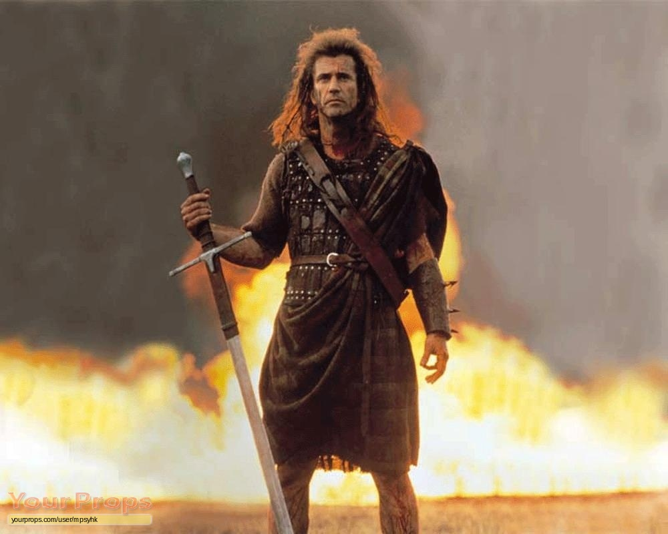
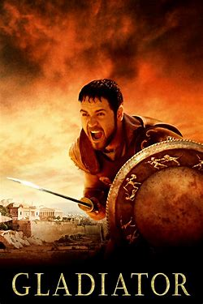
Notes:
Illustration – Let me illustrate this by looking at the typical movie plot!

Slide 10
What Did Christ Teach about Retribution:
Matthew 5:38-48 – Ye have heard that it hath been said, An eye for an eye, and a tooth for a tooth: ³⁹ But I say unto you, That ye resist not evil: but whosoever shall smite thee on thy right cheek, turn to him the other also.

Slide 11
⁴⁰ And if any man will sue thee at the law, and take away thy coat, let him have thy cloke also. ⁴¹ And whosoever shall compel thee to go a mile, go with him twain. ⁴² Give to him that asketh thee, and from him that would borrow of thee turn not thou away.

Slide 12
⁴³ Ye have heard that it hath been said, Thou shalt love thy neighbour, and hate thine enemy. ⁴⁴ But I say unto you, Love your enemies, bless them that curse you, do good to them that hate you, and pray for them which despitefully use you, and persecute you;

Slide 13
⁴⁵ That ye may be the children of your Father which is in heaven: for he maketh his sun to rise on the evil and on the good, and sendeth rain on the just and on the unjust. ⁴⁶ For if ye love them which love you, what reward have ye? do not even the publicans the same?

Slide 14
⁴⁷ And if ye salute your brethren only, what do ye more than others? do not even the publicans so? ⁴⁸ Be ye therefore perfect, even as your Father which is in heaven is perfect.

Slide 15
John 18:11 – Then said Jesus unto Peter, Put up thy sword into the sheath: the cup which my Father hath given me, shall I not drink it?

Slide 16
What did Paul teach about Retribution?
Romans 12:14 – Bless them which persecute you: bless, and curse not.
Romans 12:17 – Recompense (pay back) to no man evil for evil. Provide things honest in the sight of all men.

Slide 17
Romans 12:19 – Beloved, do not avenge yourselves, but rather give place to wrath; for it is written, "Vengeance is Mine, I will repay," says the Lord.

Slide 18
Romans 13:1-7 – Let every soul be subject to the governing authorities. For there is no authority except from God, and the authorities that exist are appointed by God. ² Therefore whoever resists the authority resists the ordinance of God, and those who resist will bring judgment on themselves.

Slide 19
³ For rulers are not a terror to good works, but to evil. Do you want to be unafraid of the authority? Do what is good, and you will have praise from the same. ⁴ For he is God's minister to you for good. But if you do evil, be afraid; for he does not bear the sword in vain; for he is God's minister, an avenger to execute wrath on him who practices evil.

Slide 20
⁵ Therefore you must be subject, not only because of wrath but also for conscience' sake. ⁶ For because of this you also pay taxes, for they are God's ministers attending continually to this very thing. ⁷ Render therefore to all their due: taxes to whom taxes are due, customs to whom customs, fear to whom fear, honor to whom honor.

Slide 21
Hebrews 12:14-16 – Pursue peace with all people, and holiness, without which no one will see the Lord: ¹⁵ looking carefully lest anyone fall short of the grace of God; lest any root of bitterness springing up cause trouble, and by this many become defiled;

Slide 22
The Truth that God is on the Throne and is the Avenger of All Evil brings:
Freedom from the poison and paralysis of bitterness.
Endurance and a Stronger faith in our Lord.
A living Hope and assurance in the Lord’s Return.

